Slide 1

Day 2 Eurocontrol June 14, 2021

Slide 2

Recap Exercise
List all prime numbers under 100
Step 1: List all numbers under 100
Step 2: Make a function to check whether a number is a prime. Prime numbers can only be divided by themselves and 1 (use mod %). You need to use a loop for this as well. If you can’t divide it by any of the numbers, it is a prime, so you return True, otherwise return False
Step 3: Check if numbers in the list are prime numbers, if they are print the number
Good luck!!

Slide 3
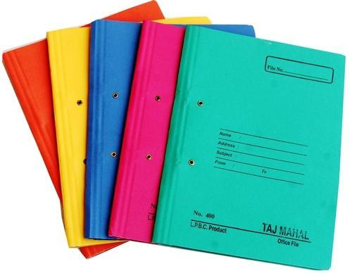

Slide 4
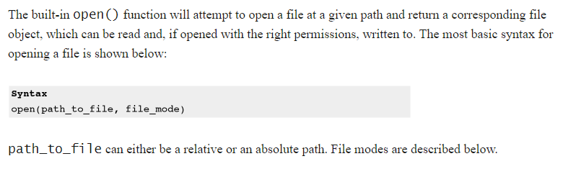
File Handling

Slide 5
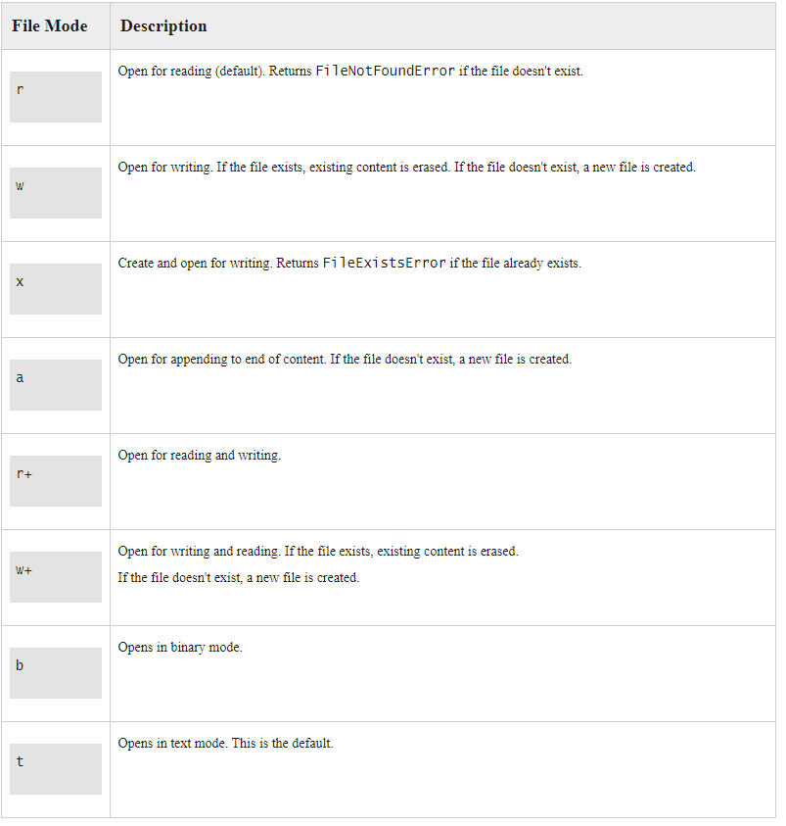
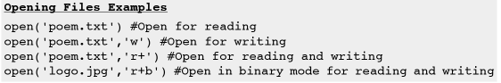

Slide 6
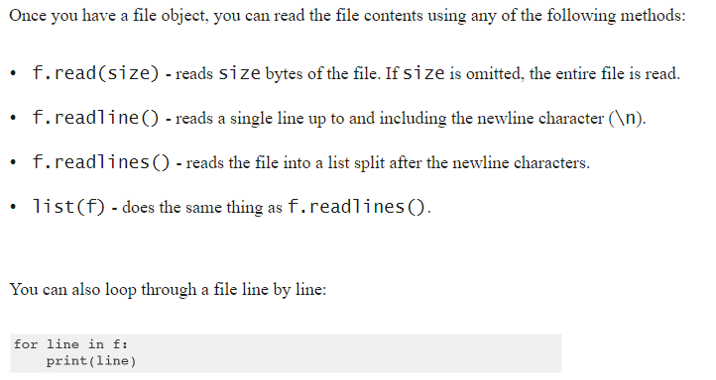
Reading Files

Slide 7
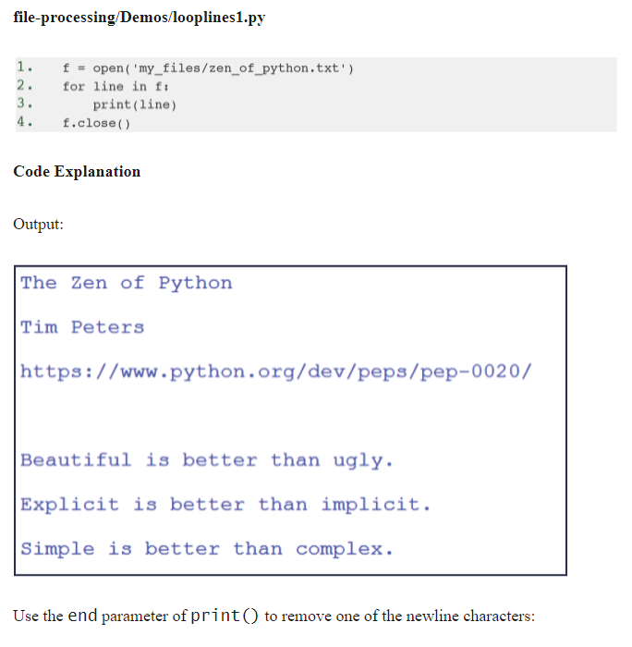

Slide 8
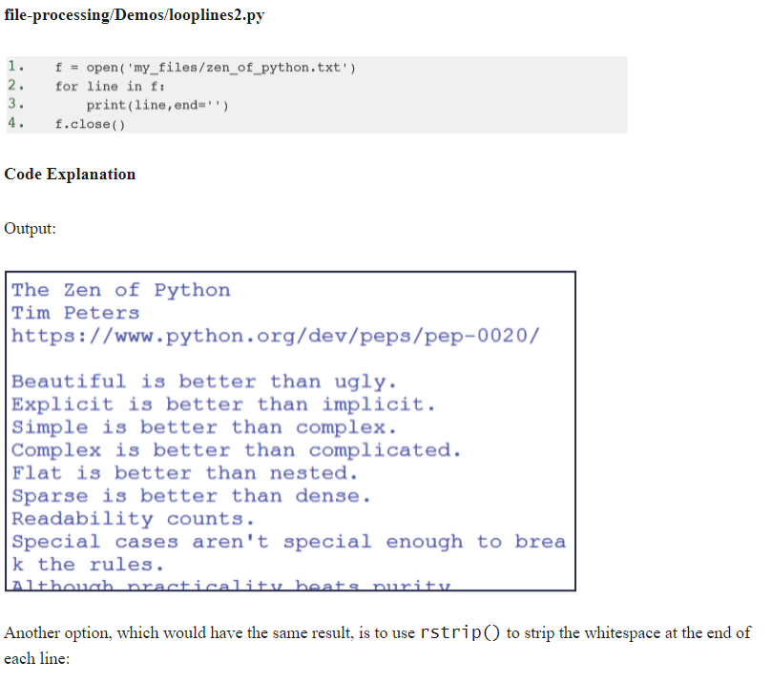

Slide 9
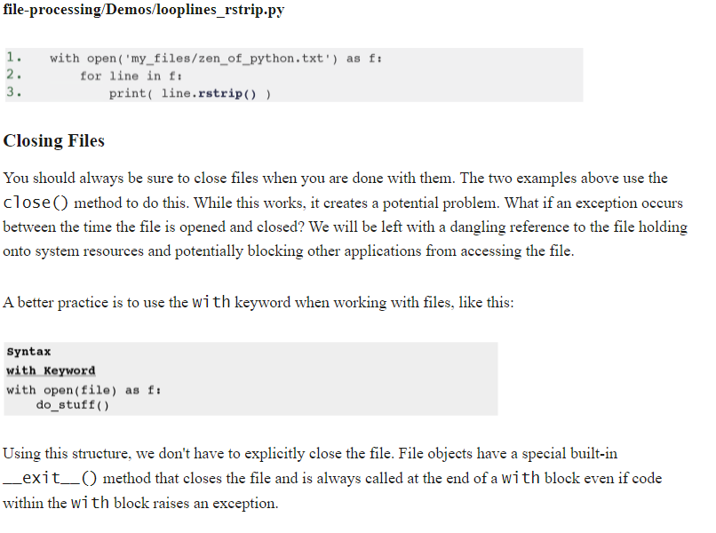

Slide 10
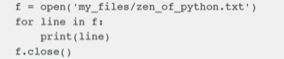
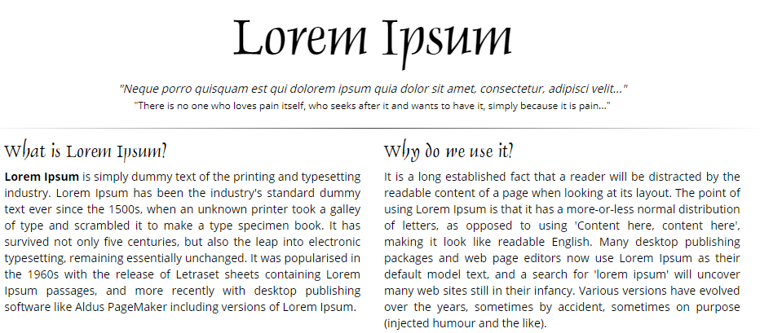
Exercise
Make a file with lipsum.org contents
Open the file
Use read, readline, readlines and the for to print (parts of) the contents

Slide 11
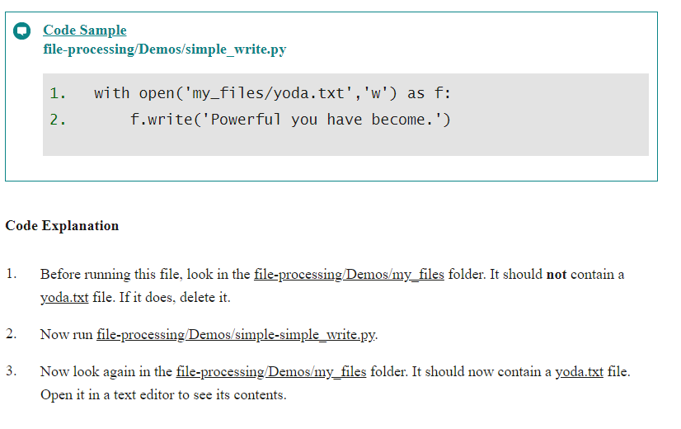
Writing to Files

Slide 12
os Methods
Import OS
Methods used to perform operations like change directory, make directory, etc

Slide 13
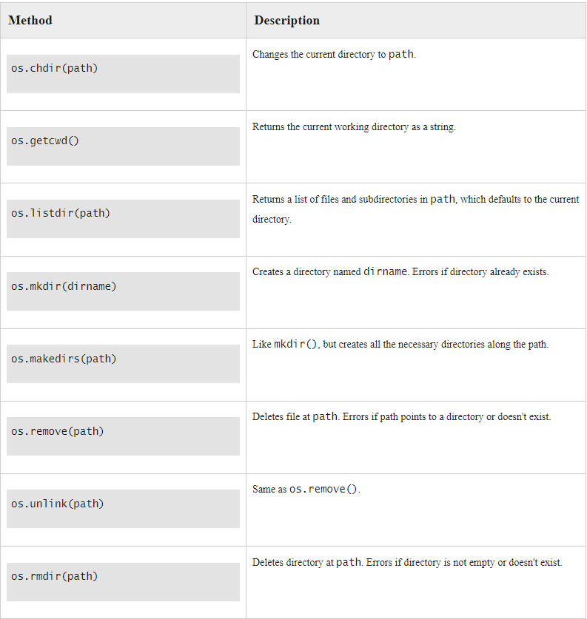
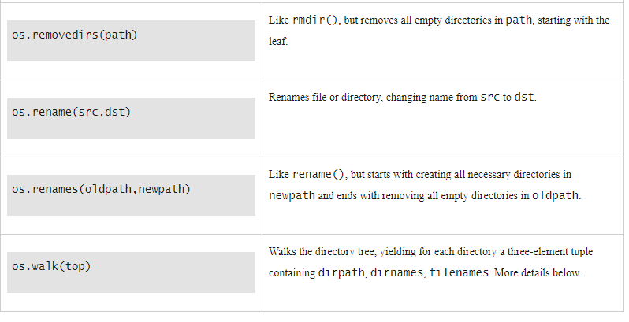

Slide 14
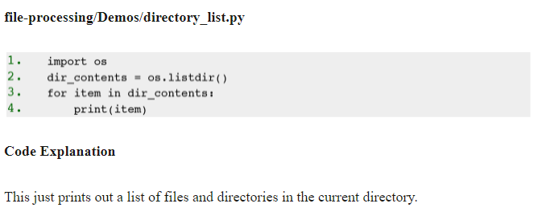
Examples – os.listdir()

Slide 15
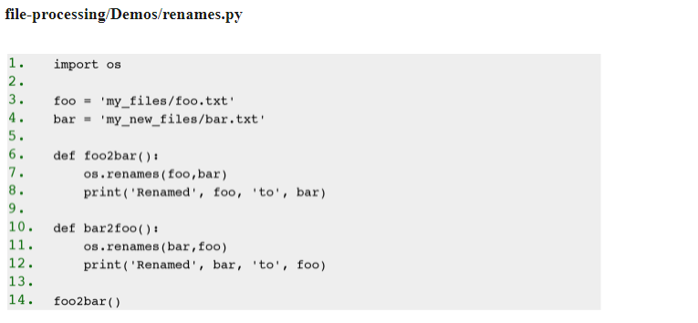
Examples – os.renames()

Slide 16
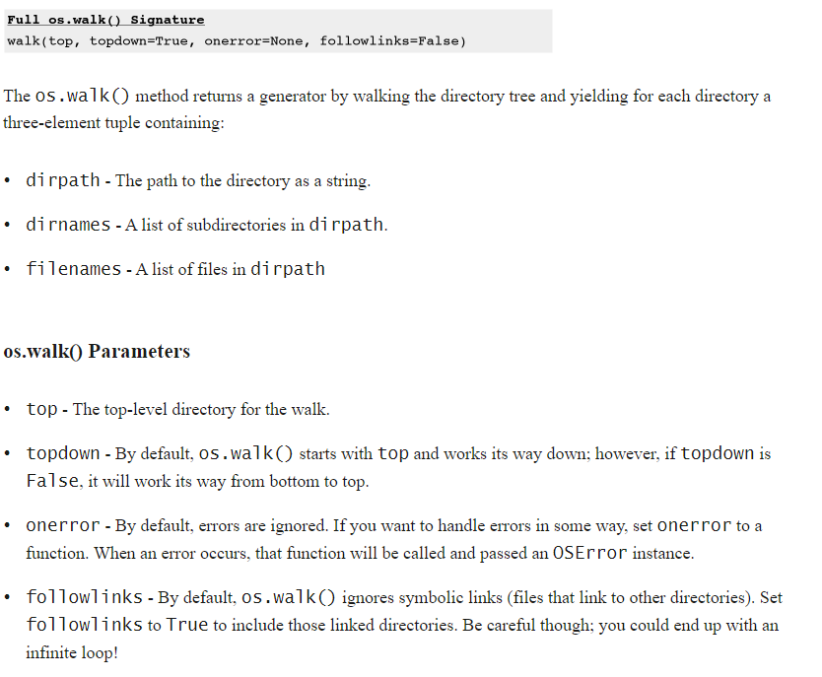
os.walk()

Slide 17
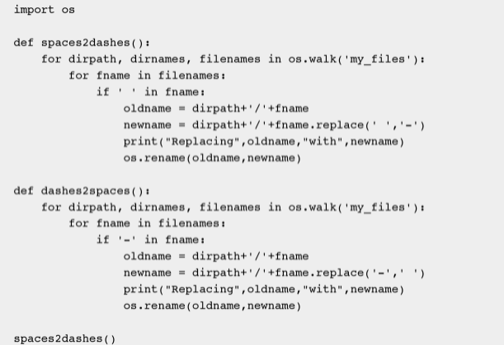

Slide 18
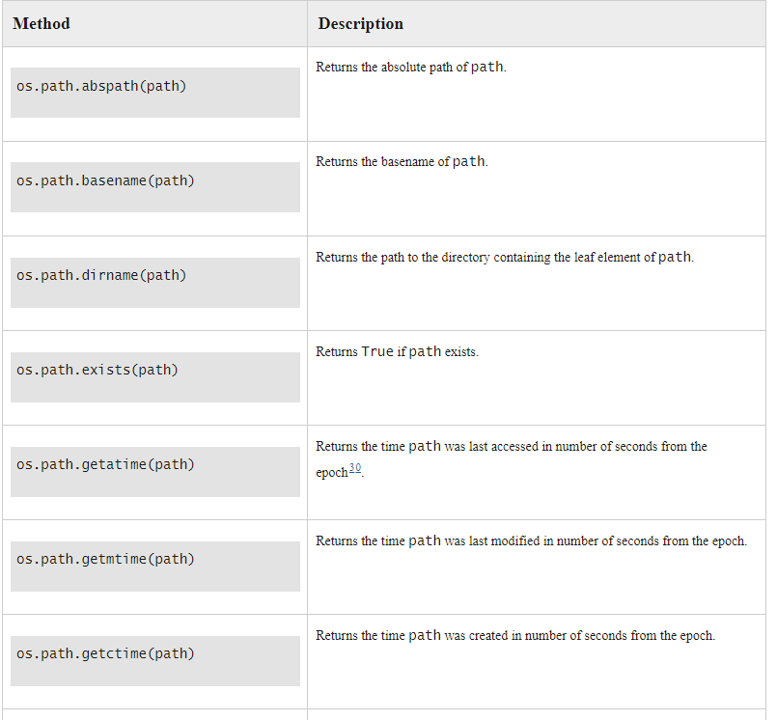
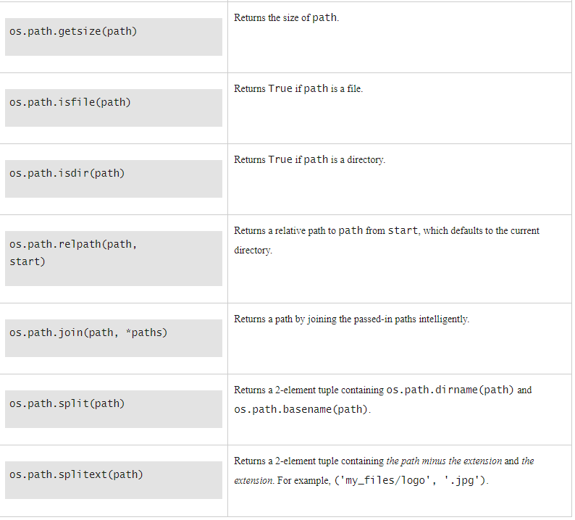
os.path()

Slide 19
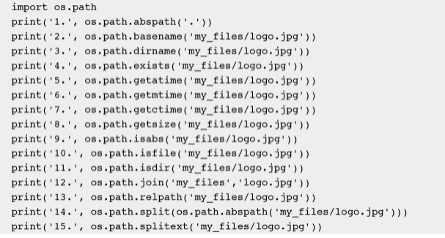
Check it

Slide 20
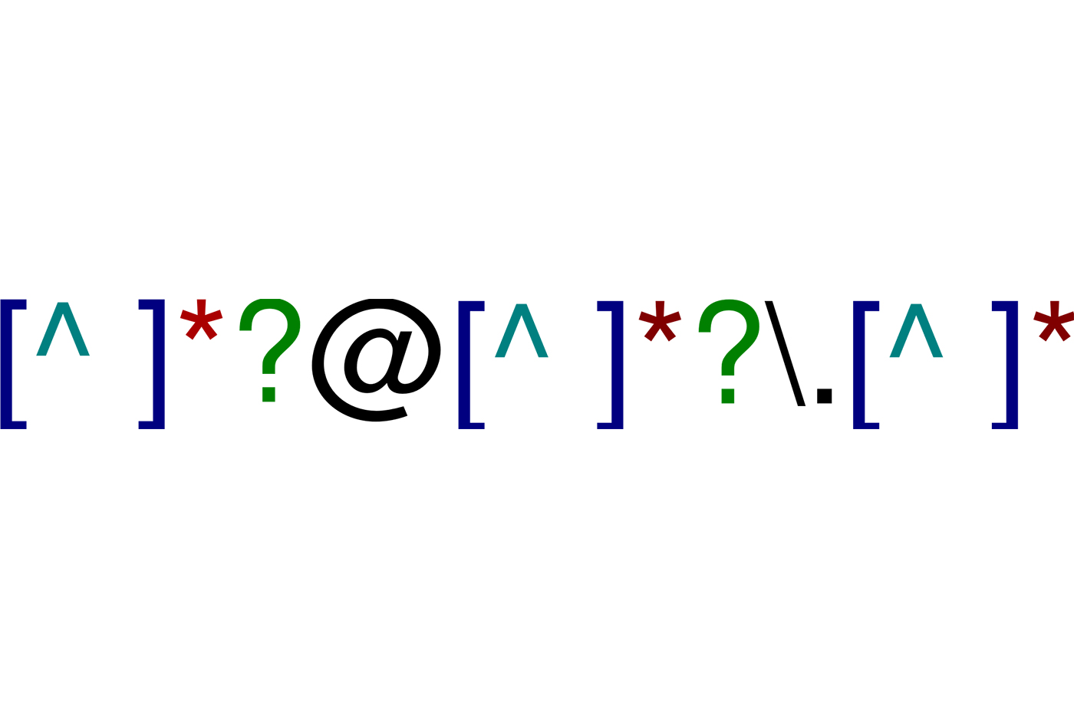

Slide 21
Regular Expressions (REGEXP)
Also called pattern matching
A way to find occurrences of a certain word, letter etc in a string
Based on wildcards
Always consists of
What are you looking for?
How many times does it need to occur?

Slide 22
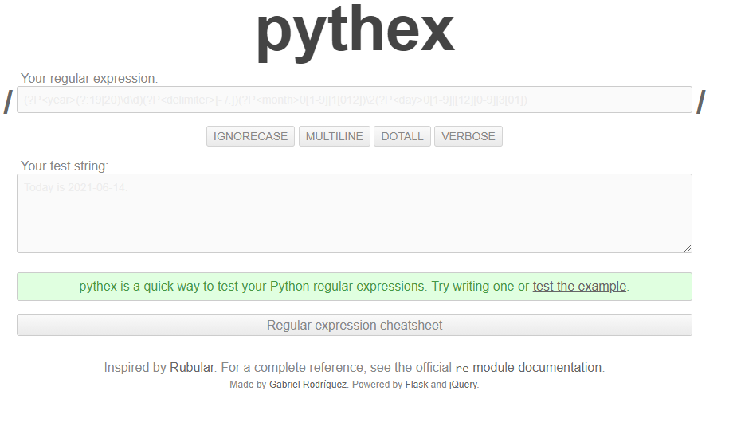
https://pythex.org/

Slide 23
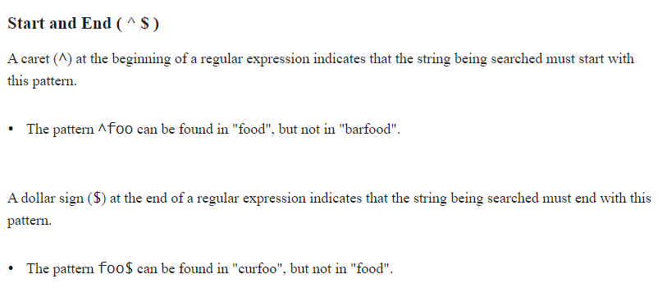
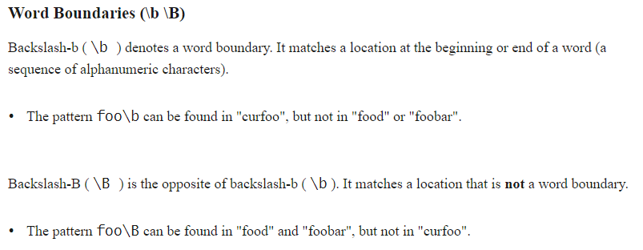

Slide 24
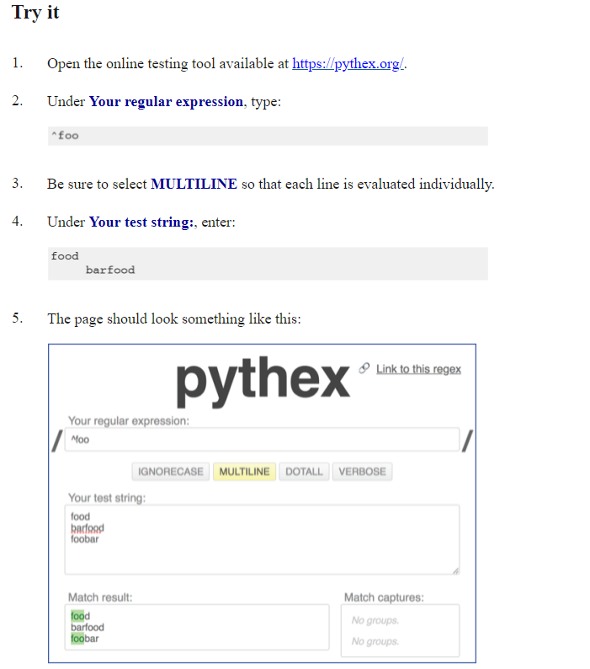

Slide 25
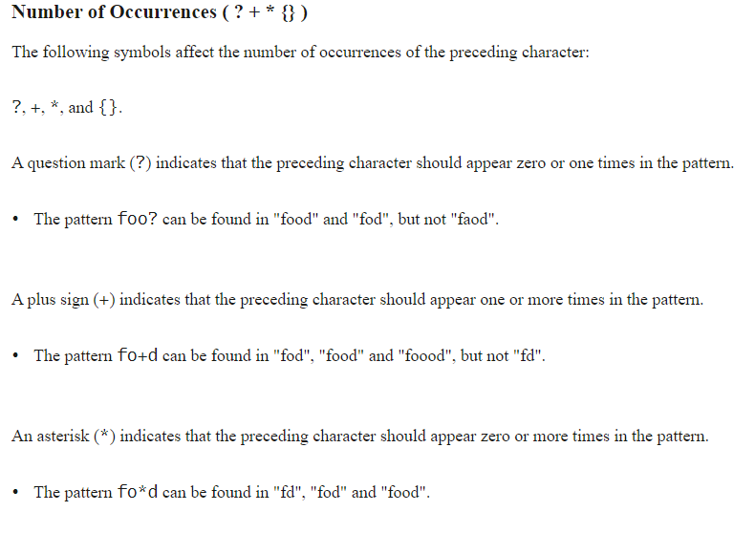

Slide 26
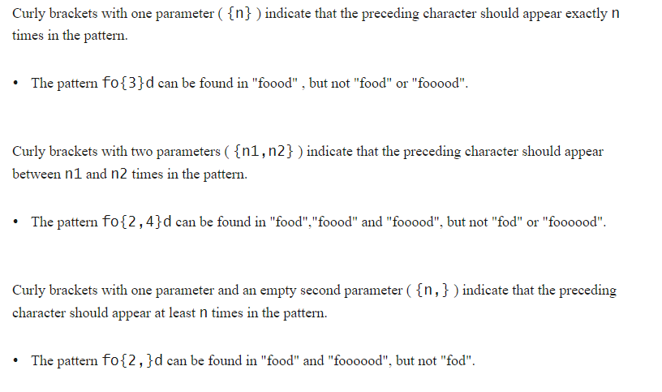

Slide 27
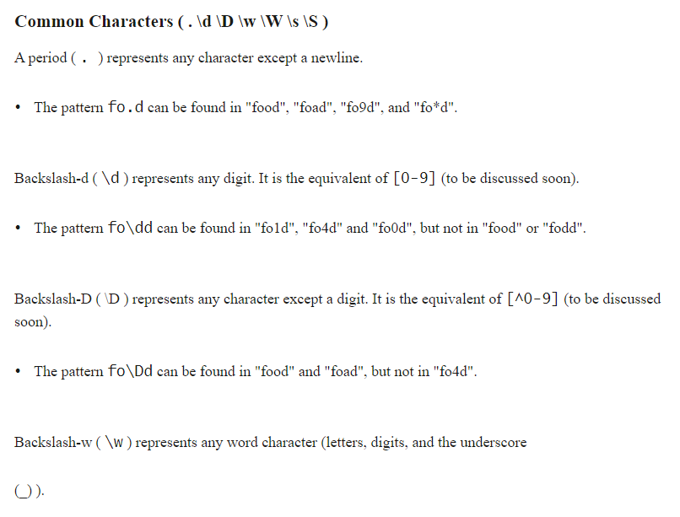

Slide 28
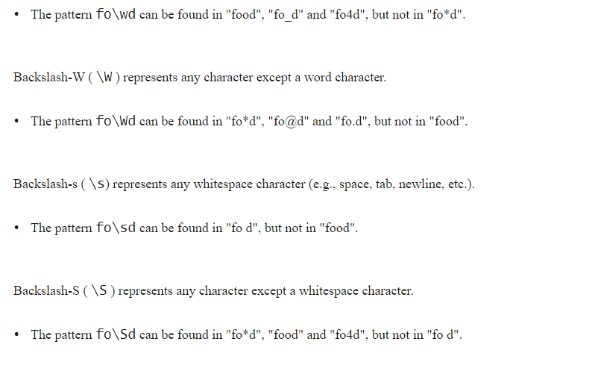

Slide 29
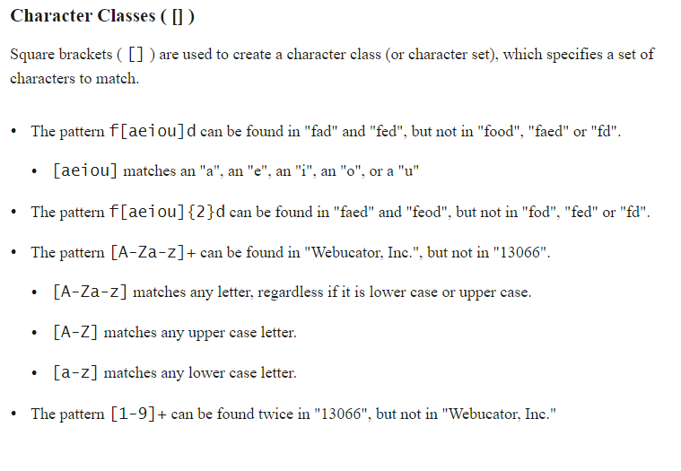

Slide 30
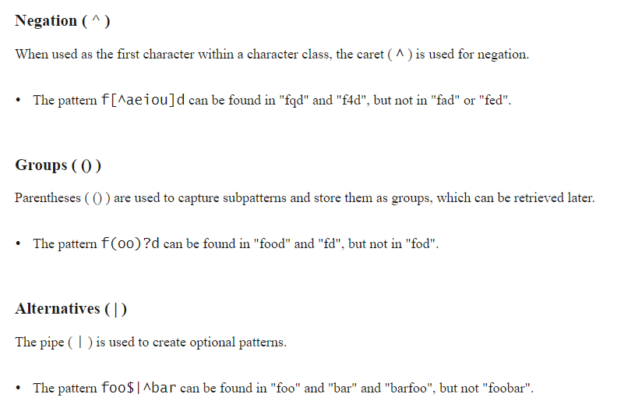

Slide 31
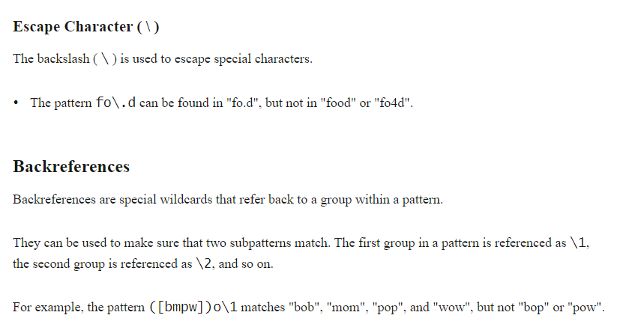

Slide 32
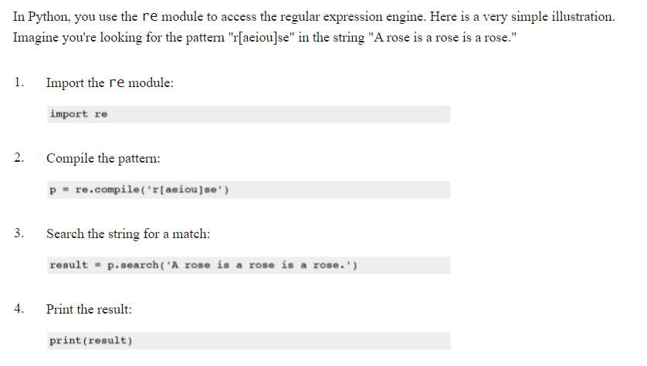
Using Python

Slide 33
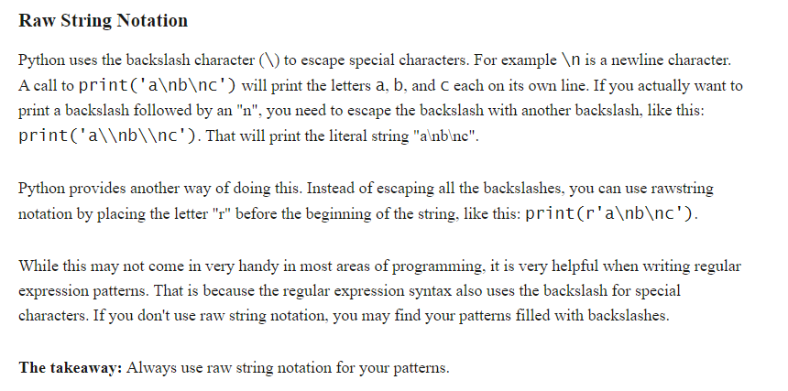
Raw String ‘r’

Slide 34
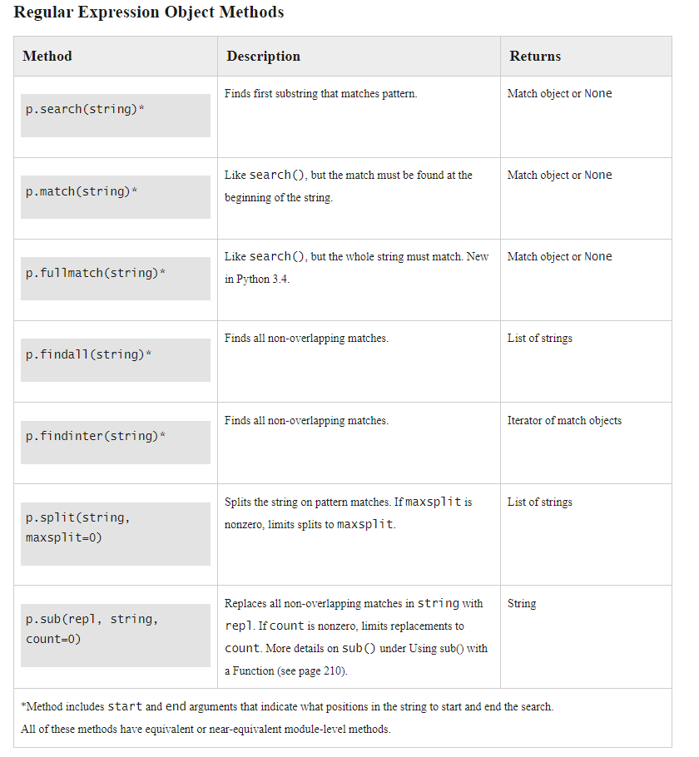

Slide 35
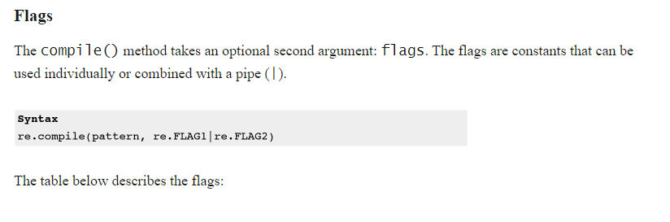
Patter match options, FLAGS

Slide 36
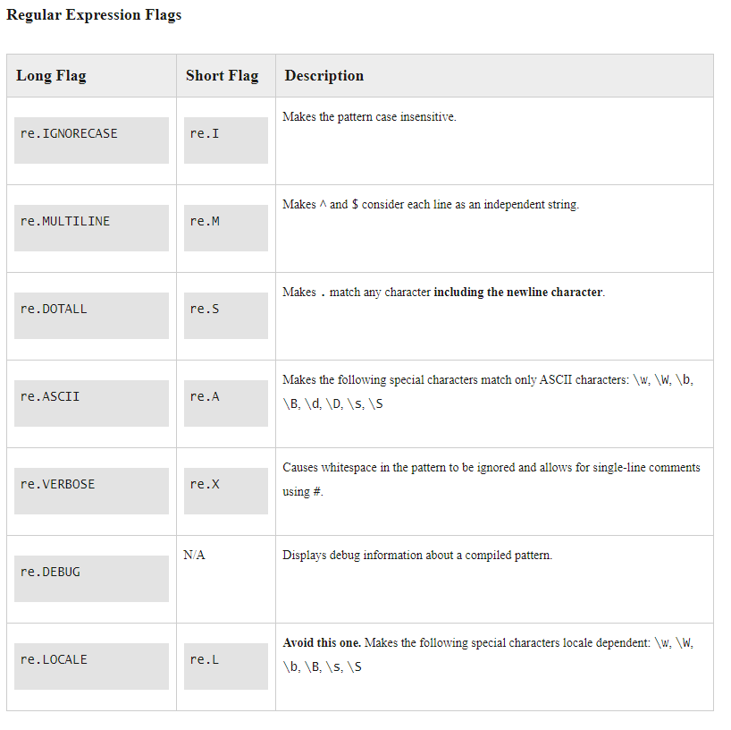

Slide 37
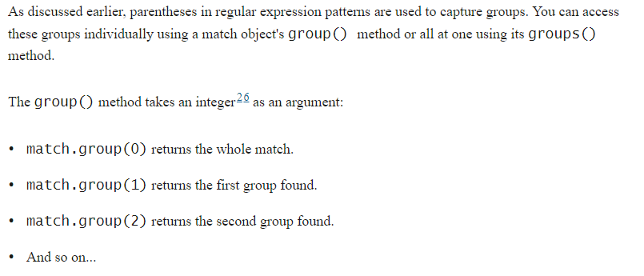
Groups

Slide 38
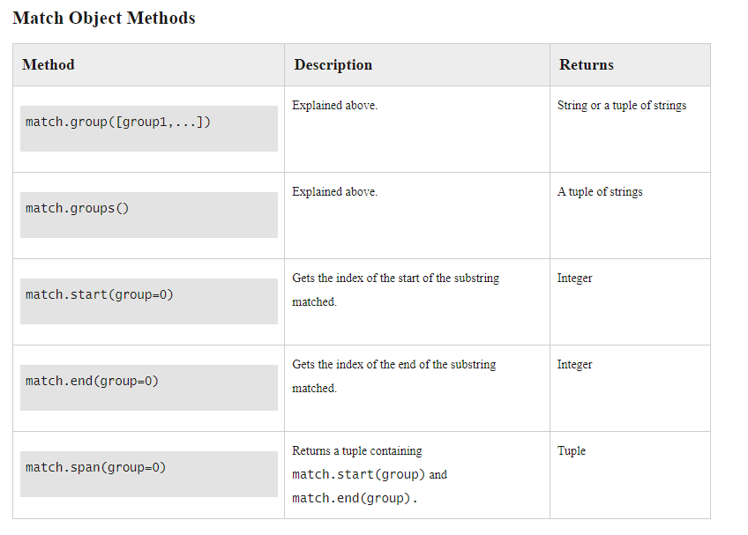

Slide 39
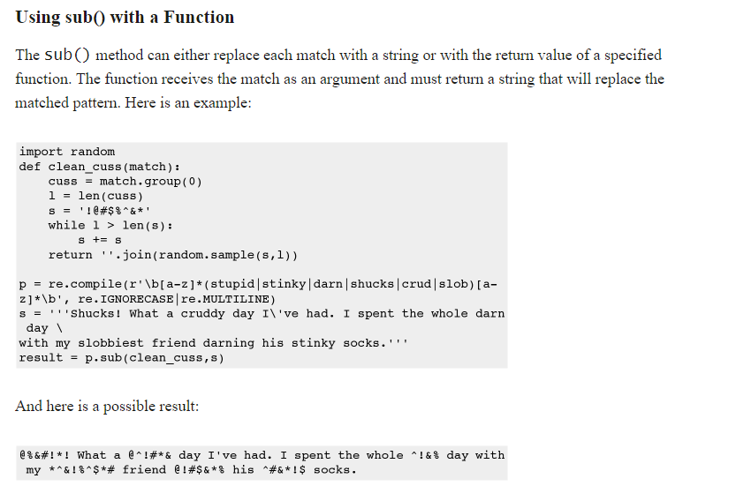

Slide 40
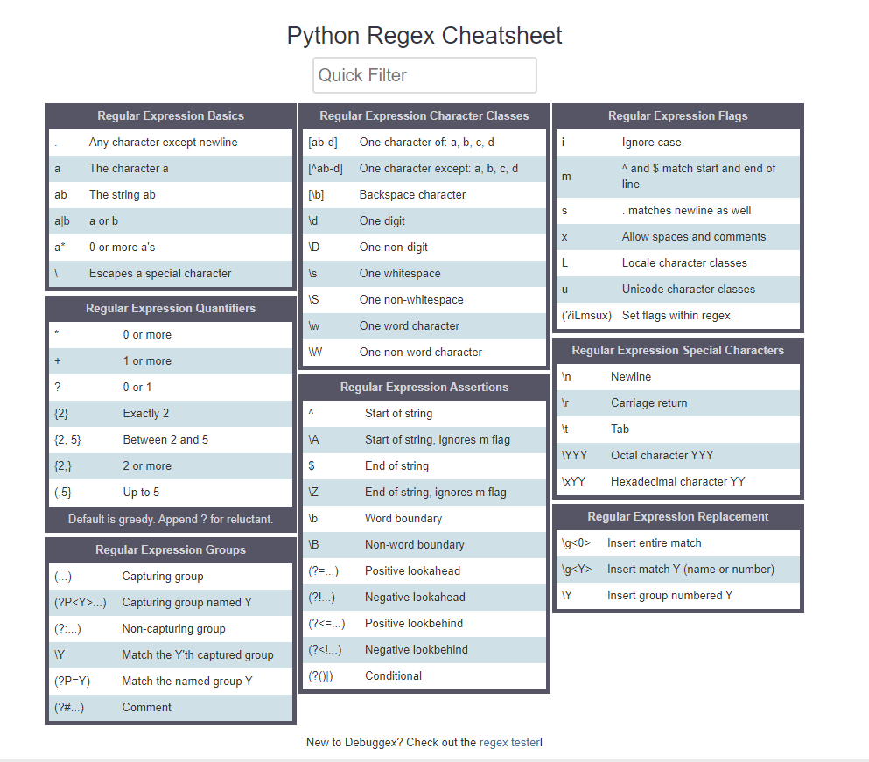
https://www.debuggex.com/cheatsheet/regex/python

Slide 41
Exercise
Check pythex site to test your pattern
\w+@\w+\.\w+
Read the lines from regex.txt
Check if they contain a valid email address
Print the results
BONUS: Put the emails randomly in the loremipsum file you made before and see if you can still find the emails.
BONUS2: Make multiple files and check all text files in a directory for email addresses

Slide 42
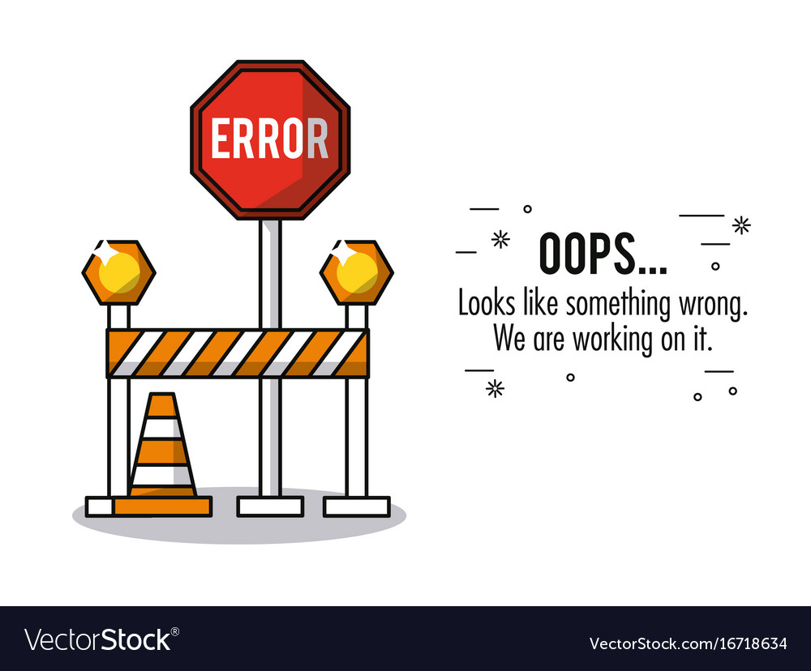

Slide 43
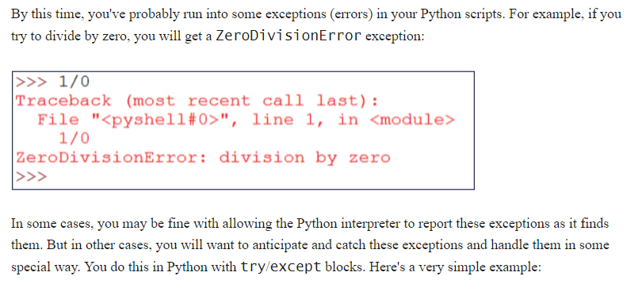
Exception Handling

Slide 44
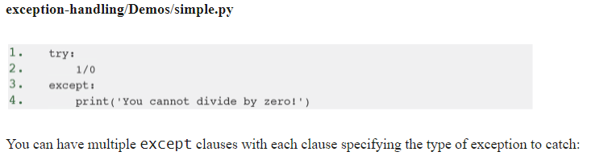
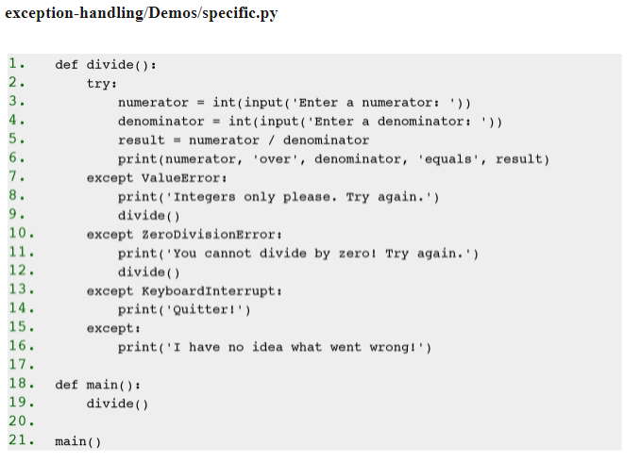
Notes:
If the user enters anything other than an integer for the numerator or denominator, the int() function will fail and a ValueError exception will be thrown.
•
If the user enters 0 for the denominator, a ZeroDivisionError exception will be thrown.
•
If the user quits the program by pressing CTRL+C, a KeyboardInterrupt exception will be thrown.
•
The last except clause, which is optional, serves as a wildcard to catch any unspecified exception types.

Slide 45
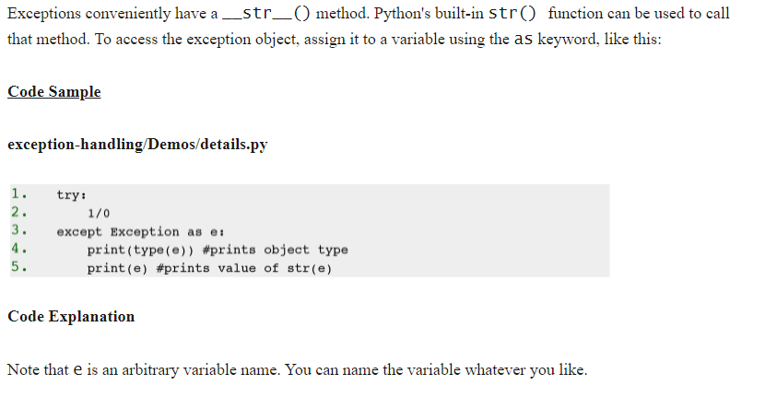
Exception Information

Slide 46
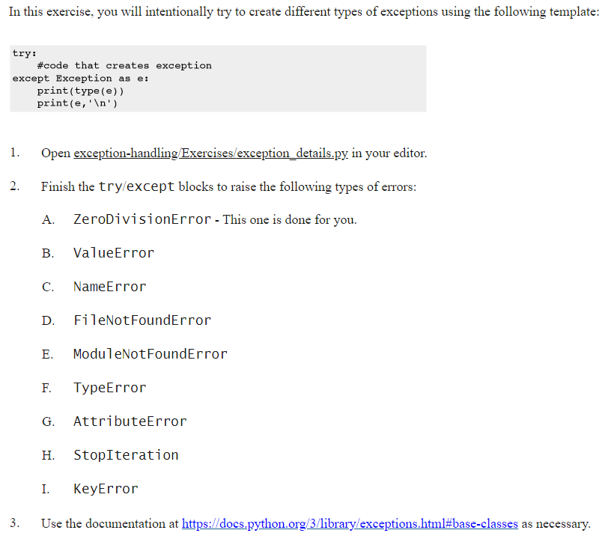

Slide 47
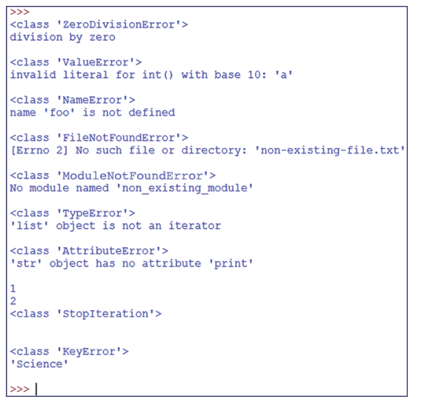
Exercise Output

Slide 48
Else Clause
We want to limit our try clause to the code that might cause an exception. After the final except clause, we can include an else clause that contains code that only runs if no exception was raised in the try clause. Take a look at the following example:

Slide 49
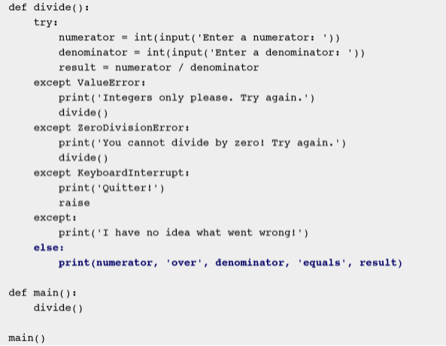

Slide 50
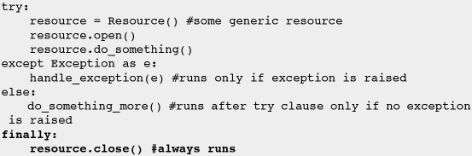
Finally Clause
The finally clause is for doing any necessary cleanup (e.g., closing connections, releasing resources, etc.). Here is a pseudo-example:

Slide 51

Flow Control with Exceptions

Slide 52

Exercise: Running Sum

Slide 53


Slide 54

Object Oriented Programming

Slide 55
Classes - OOP
Object Oriented Programming
Benefits:
Reusability
Code Maintenance
Easier Troubleshooting
Flexibility

Slide 56

Attributes

Slide 57

Behaviors

Slide 58

Classes vs Objects

Slide 59

Everything is an Object

Slide 60

Everything is an Object II

Slide 61

Creating Custom Classes

Slide 62

Die Class

Slide 63
Attributes and Methods
Every function always gets the ‘self’ parameter
Sides = 6 means the default value will be 6
__init__ is a special function used to initialize the object

Slide 64

Exercise: Add a Roll method to the Die

Slide 65

Custom methods

Slide 66

Exercise: Challenge
The Counter collection generates a Dictionary of all value and how often they occur.
from collections import Counter

Slide 67

Calling the roll method

Slide 68

Attributes
By using self.attributename you can add an attribute to a class
For instance

Slide 69
Encapsulation (private attributes)
The convention is using an underscore in front of the name
For instance _radius, _name, etc
This doesn’t actually prevent people from calling it in Python, unlike in languages like C#, Java, etc
Make getters and setters for variables to change the values if needed

Slide 70


Encapsulation (private attributes)

Slide 71

Properties
Using get_ and set_ methods can be annoying
Luckily there is another way

Slide 72


Properties 2
We can use the property keyword

Slide 73


Exercise: Properties

Slide 74

Solution

Slide 75

Inheritance Concept
Name
Weight
MakeNoise()
Name
Weight
Breed
MakeNoise()
Walk()
Bark()

Slide 76

Inheritance

Slide 77

Example

Slide 78


Exercise: Weighted Die

Slide 79

Extending a class method

Slide 80

Exercise: Extending the Roll Method

Slide 81

Solution

Slide 82


Class methods and Attributes

Slide 83


Slide 84
Date Time Functions
The epoch is the moment that a computer or computer language considers time to have started. Python considers the epoch to be January 1, 1970 at midnight (1970-01-01 00:00:00).Times before the epoch are expressed internally as negative numbers.

Slide 85
Clocks
time.clock() - deprecated in 3.3
time.monotonic() - new in 3.3
time.perf_counter() - new in 3.3
time.process_time() - new in 3.3
time.time()

Slide 86


Absolute time: time.time()

Slide 87


Relative time: time.perf_counter()

Slide 88

Time Structures
In addition to expressing time in seconds since the epoch as time.time() does, time can be expressed as a special time.struct_time object, which is a type of tuple. The time.struct_time object for the epoch looks like this:

Slide 89


Slide 90

Converting to struct

Slide 91

Exercise
Get the individual year, month, day from the structure
Make a struct with the same date from last year
Print the 4 dates like 15-06-2021, using the structure
Check names!

Slide 92

Converting to string: time.asctime()
Converts a time expressed as a struct_time to a date represented as a string. If the struct_time argument is omitted, it defaults to time.localtime(), which returns the current local time.

Slide 93

Time and formatted string
https://docs.python.org/3/library/time.html#time.strftime

Slide 94

Waiting: time.sleep(secs)

Slide 95
Exercise
Maak een loop die seconden en tienden van seconde telt.
Output:
0.1
0.2
0.3
0.4
…
5.0
EINDE

Slide 96
datetime module
datetime.date - a date with year, month, and day attributes.
datetime.time - a time with hour, minute, second, microsecond, and tzinfo attributes.
datetime.datetime - a combination of datetime.date and datetime.time.
datetime.timedelta - a duration expressing the difference between instances of two datetime.date, datetime.time, or datetime.datetime objects.

Slide 97
datetime.date objects
There are a number of datetime methods for creating datetime.date objects:
datetime.date(year, month, day)
date.today() - Returns the current local date.
date.fromtimestamp(timestamp) - Returns the local date corresponding to timestamp.

Slide 98

Attributes

Slide 99

Methods

Slide 100

datetime.time objects
datetime.time objects are created with the datetime.time() method, which takes the following arguments:
hour - defaults to 0
minute - defaults to 0
second - defaults to 0
microsecond - defaults to 0
tzinfo - defaults to None.

Slide 101

Attributes

Slide 102

Methods

Slide 103
datetime.datetime objects
A datetime.datetime object is a combination of a datetime.date object and a datetime.time object. There are a number of datetime methods for creating datetime.datetime objects:
datetime(year, month, day, hour, minute, second, microsecond, tzinfo)
datetime.today() - Returns the current local date and time.
datetime.now() - like datetime.today() but allows for time zone to be set.
datetime.utcnow() - Returns the current UTC date and time.

Slide 104

datetime.datetime object
Continued…
datetime.fromtimestamp(timestamp) - Returns the local date and time corresponding to timestamp.
datetime.utcfromtimestamp(timestamp) - Returns the UTC date and time corresponding to timestamp.
datetime.combine(datetime.date, datetime.time) - Combines a datetime.date object and datetime.time object into a single datetime.datetime object.
datetime.strptime(date_string, format) - Like time.strptime(string[, format]) with the same formatting directives.

Slide 105

Attributes

Slide 106


Methods

Slide 107

Datetime.timedelta object
datetime.timedelta objects can be:
Added (t1 + t2). Result: a new datetime.timedelta object.
Subtracted (t1 - t2). Result: a new datetime.timedelta object.
Divided (t1 / t2). Result: a float.
Multiplied by an integer or float (t1 * 2). Result: a new datetime.timedelta object.
Divided by an integer or float (t1 / 2). Result: a new datetime.timedelta object.

Slide 108

Atrributes

Slide 109

Methods

Slide 110

Exercise

Slide 111


Slide 112


Slide 113


Slide 114

Challenge Solution

Slide 115

Solution

